Slide 1



Chapter 12
Complex
Experimental
Designs
@ 2012 Wadsworth, Cengage Learning

Slide 2
Topics
Using Designs with More Than One Independent Variable
Statistical Analysis of Complex Designs

Slide 3
Using Designs with More Than One Independent Variable

Slide 4
Using Designs with More Than One Independent Variable
Factorial design: a design with more than one independent variable
Advantage: allow us to assess how variables interact
Complete factorial design
  One in which all levels of each independent variable are paired with all levels of every other independent variable

Slide 5
Using Designs with More Than One Independent Variable (cont’d.)
Incomplete factorial design
  Also has more than one independent variable
  However, all levels of each variable are not paired with all levels of every other variable
Factorial notation indicates:
  How many independent variables are used in a study
  How many levels are used for each variable

Slide 6
Main Effects and Interaction Effects
Main effect: an effect of a single independent variable
Interaction effect: the effect of each independent variable across the levels of the other independent variables

Slide 7
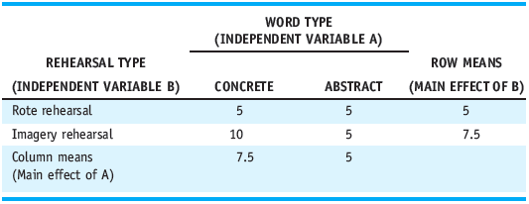
Main Effects and Interaction Effects (cont’d.)
Table 12.1 Results of the 2 X 2 Factorial Design: Effects of Word Type and Rehearsal Type on Memory

Slide 8
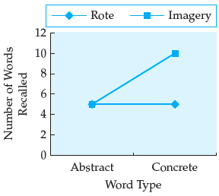
Main Effects and Interaction Effects (cont’d.)
Figure 12.1
Line graph representing interaction between rehearsal type and word type

Slide 9
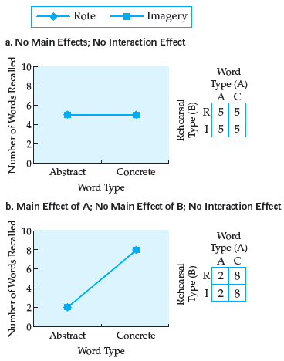
Figure 12.2
Possible outcomes of a 2 X 2 factorial design with rehearsal type and word type as independent variables

Slide 10
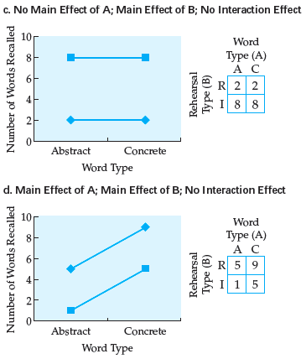
Figure 12.2
Possible outcomes of a 2 X 2 factorial design with rehearsal type and word type as independent variables (cont’d.)

Slide 11
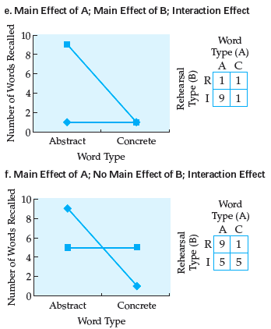
Figure 12.2
Possible outcomes of a 2 X 2 factorial design with rehearsal type and word type as independent variables (cont’d.)

Slide 12
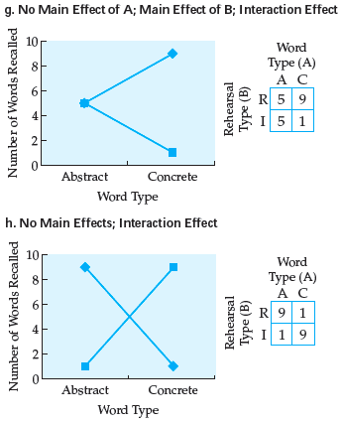
Figure 12.2
Possible outcomes of a 2 X 2 factorial design with rehearsal type and word type as independent variables (cont’d.)

Slide 13
Statistical Analysis of
Complex Designs

Slide 14
Statistical Analysis of
Complex Designs
Two-way ANOVA
  Similar to a one-way ANOVA
  Difference: between-groups variance may be attributable to:
    Factor A
    Factor B
    Interaction of factors A and B

Slide 15
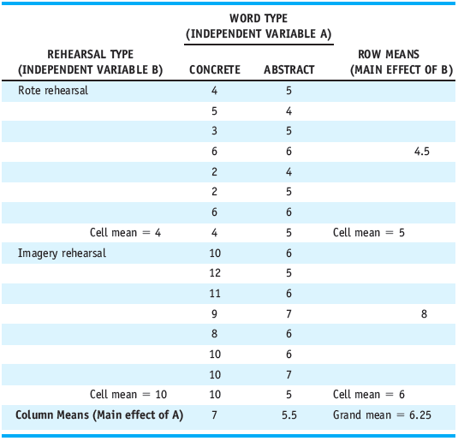
Table 12.2 Number of Words Recalled as a Function of Word Type and Rehearsal Type

Slide 16
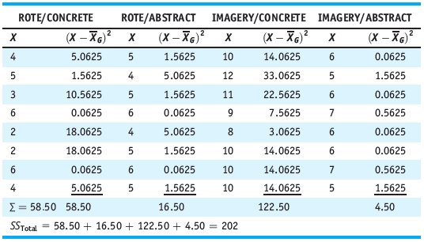
Statistical Analysis of
Complex Designs (cont’d.)
Table 12.3 Calculation of SS_{Total} Using the Definitional Formula

Slide 17
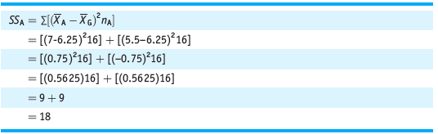
Statistical Analysis of
Complex Designs (cont’d.)
Sum of squares factor A
  The sum of the squared deviation scores of each group mean for factor A minus the grand mean times the number of scores in each factor A condition
Table 12.4 Calculation of SS_{A} Using the Definitional Formula

Slide 18
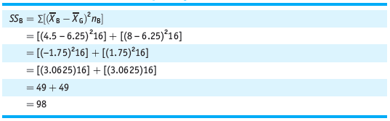
Statistical Analysis of
Complex Designs (cont’d.)
Sum of squares factor B
  The sum of the squared deviation scores of each group mean for factor B minus the grand mean times the number of scores in each factor B condition
Table 12.5 Calculation of SS_{B} Using the Definitional Formula

Slide 19
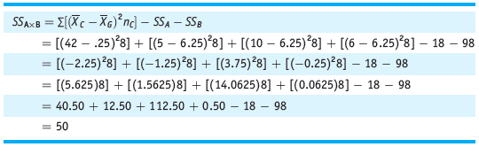
Statistical Analysis of
Complex Designs (cont’d.)
Sum of squares interaction
  The sum of the squared difference of each condition mean minus the grand mean times the number of scores in each condition
  SS_{A} and SS_{B} are then subtracted from this sum
Table 12.6 Calculation of SS_{A} _{X B} Using the Definitional Formula

Slide 20
Statistical Analysis of
Complex Designs (cont’d.)
Sum of squares error
  The sum of the squared deviations of each score from its group mean
  The within-groups sum of squares in a factorial design

Slide 21
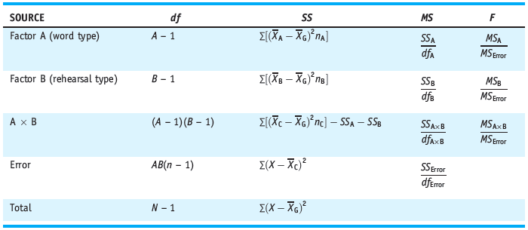
Statistical Analysis of
Complex Designs (cont’d.)
Table 12.8 ANOVA Summary Table: Definitional Formulas

Slide 22
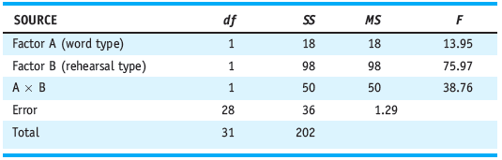
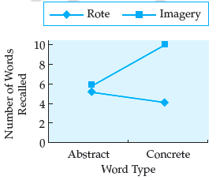
Table 12.9 Two-Way ANOVA Summary Table
Figure 12.3 Number of words recalled as a function of word type and rehearsal type

Slide 23
Statistical Analysis of
Complex Designs (cont’d.)
Assumptions of the two-way randomized ANOVA:
  Used when you have a factorial design
  All conditions contain independent samples of subjects
  Interval or ratio data are collected
  The populations represented by the data:
    Are roughly normally distributed
    All have homogeneous variances

Slide 24
Statistical Analysis of
Complex Designs (cont’d.)
Two-way repeated measures ANOVA
  Similar to the two-way randomized ANOVA
  More advanced statistics are required
Mixed ANOVAs: one variable is manipulated between subjects and one within subjects

Slide 25
Statistical Analysis of
Complex Designs (cont’d.)
Three-way ANOVA
  Three main effects
  Three two-way interactions
  One three-way interaction to interpret
MANOVA
  Advanced statistics
  Interpret them in a similar fashion to statistics we have covered

Slide 26
Statistical Analysis of
Complex Designs (cont’d.)
Meta-analysis
  Advanced statistical procedure
  Combines, tests, and describes the results from many different studies
  Enables us to draw more objective conclusions about the generalizability of research findings

Slide 27
Summary
Advantages of using designs that use more than one independent variable
Concepts of factorial notation, main effects, and interaction effects
Graph data from a factorial design
Statistical analysis using a two-way randomized ANOVA
Assumptions and interpretations of the two-way randomized ANOVA

